Slide 1

Vertebrate Race
E x p l o r I n g t h e a d a p t a t I o n s o f v e r t e b r a t e s

Slide 2
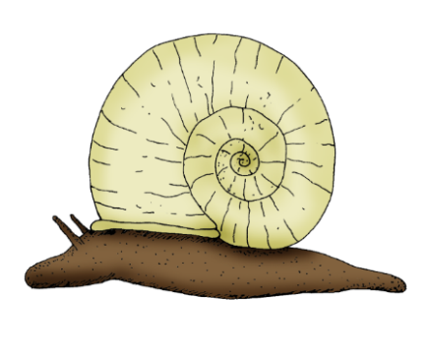

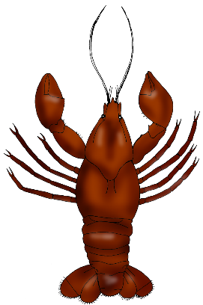
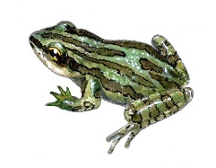
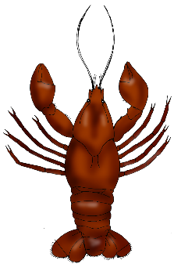
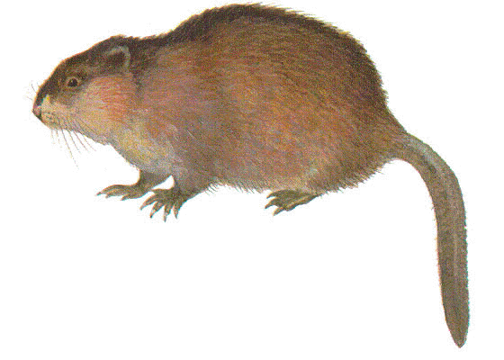
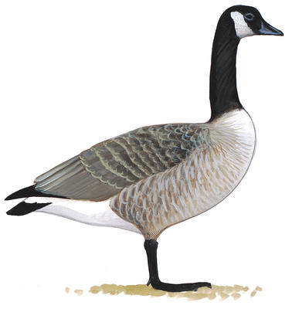
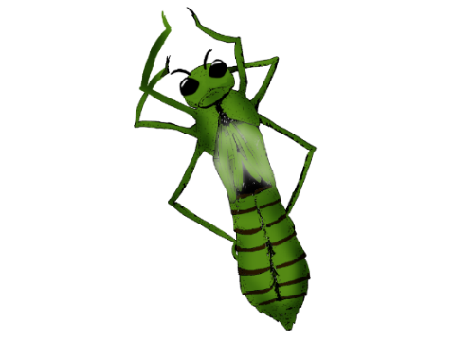
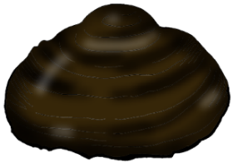

What are vertebrates?
All animals can be divided into two groups:
vertebrates and invertebrates.
A vertebrate
is a living thing with a spine, used to support the body.
An invertebrate
is a living thing which does not have a spine.
Goose from audobon.org. Muskrat from naturalunseenhazards.wordpress.com. Boreal Chorus Frog from torontozoo.com. Mussel, Dragonfly Nymph, crayfish and Pond Snail developed by Oak Hammock Marsh Interpretive Centre.

Slide 3
The Diversity of Vertebrates
Although the majority of all living things are invertebrates, there is still a great diversity amongst vertebrates. This great diversity is further classified in order to better understand this large group of living things.
A classification system is a means to sort, arrange and organize a large group, dividing the group into smaller subgroups.
Classification is used in science in order to:
Learn and better understand life’s diversity
Recognize the similarities and differences between living things
Help us identify living things

Slide 4
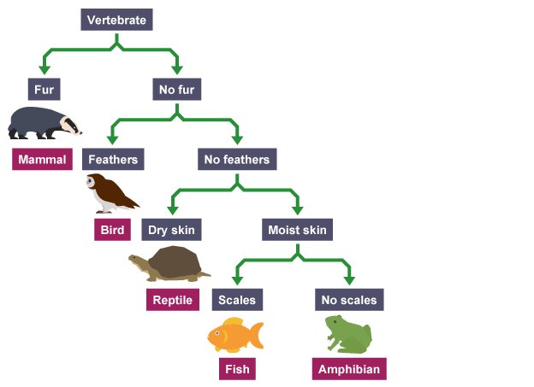
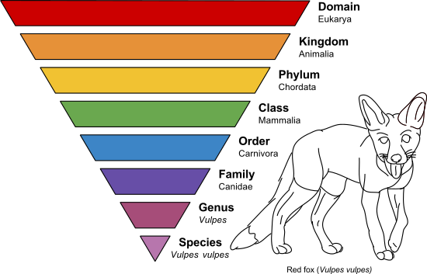
Classifying Vertebrates
Taxonomy is one way to classify living things.
All vertebrates will be classified under the Domain Eukarya (living things with a membrane-bound nucleus), in Kingdom Animalia (are multicellular, and have locomotion abilities), and under one Phylum (Chordata).
The rank of Class is where vertebrates differ.
Today, we will focus on vertebrates from Class:
Mammalia (Mammals),
Amphibia (Amphibians),
Reptilis (Reptiles),
Aves (Birds),
and Osteichthyes
(Bony Fish).

Slide 5
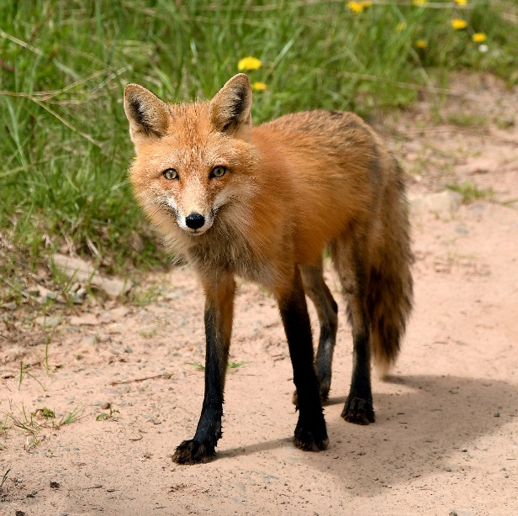
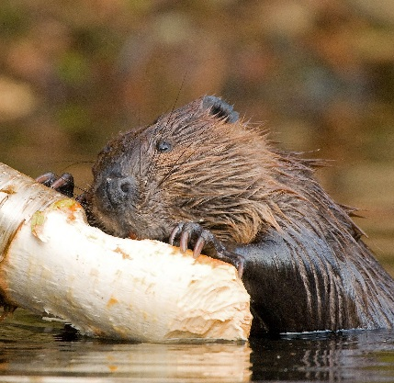
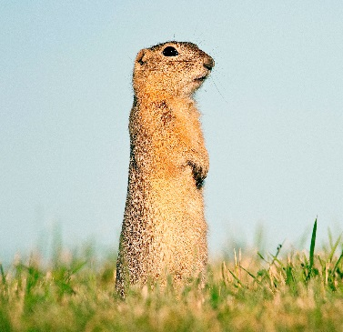
Class Mammalia - Mammals
Key Characteristics:
Young are fed milk from mammary glands
Endothermic (warm-blooded)
Have hair during at least one part of their life cycle
Have a diaphragm – muscle that separates the chest from the lower half of the body
Lower jaw is a single bone & middle ear is made up of three bones
Breathe with lungs
Mammal Examples:
Red Fox, Beaver, Richardson’s Ground Squirrel
All photos from Ducks Unlimited Canada.
Notes:
Endothermic – can maintain an internal temperature

Slide 6
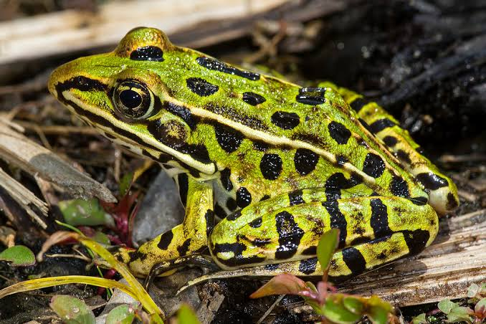
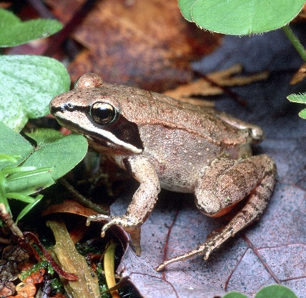
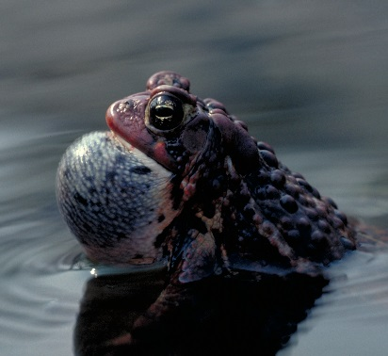
Class Amphibia - Amphibians
Key Characteristics:
Hatch from unshelled (jelly-like) eggs
Ectothermic (cold-blooded)
Moist, permeable skin
Young are filter feeders, eating plants and animals; adults are carnivorous (meat-eating)
Breathe with lungs, gills and the skin
Tetrapods – possess four limbs
Amphibian Examples:
Northern Leopard Frog, Wood Frog, American Toad
Photos from Ducks Unlimited Canada and Alan W. Wells.
Notes:
Ectothermic - cannot maintain an internal body temperature, require outside heat sources to get the body moving (then can generate heat through friction)
Moist, permeable skin - that is way most amphibians live in moist environments, otherwise they would lose water from their skin and dry up
Breathe from lungs, gills and through the skin (called cutaneous respiration, where gas exchange occurs through the skin)

Slide 7
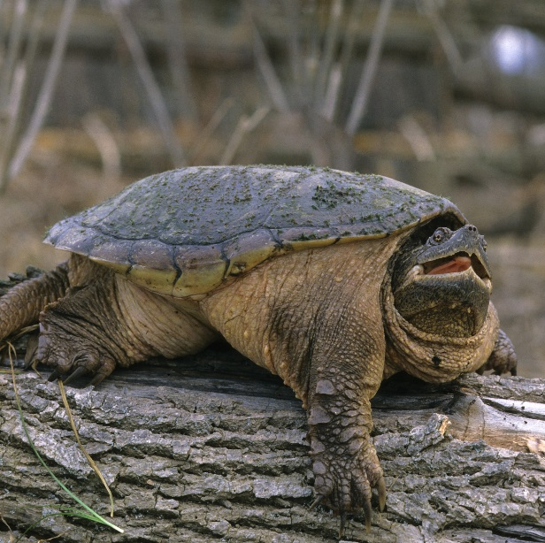
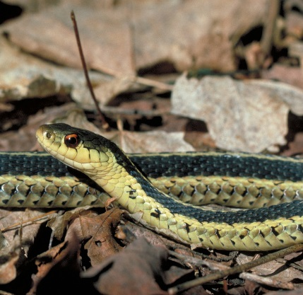
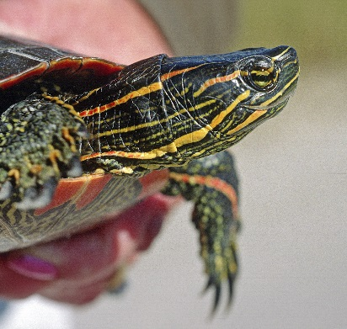
Class Reptilis - Reptiles
Key Characteristics:
Hatch from shelled eggs
Ectothermic (cold-blooded)
Dry, scaly skin (can also be covered by bony plates)
Breathe with lungs
Most are tetrapods (possess four limbs) while those that are legless (like snakes) descended from four-limbed creatures
Reptile Examples:
Snapping Turtle, Western Plains Garter Snake, Painted Turtle
All photos from Ducks Unlimited Canada.
Notes:
Ectothermic - can not maintain an internal body temperature, require outside heat sources to get the body moving (then can generate heat through friction)

Slide 8
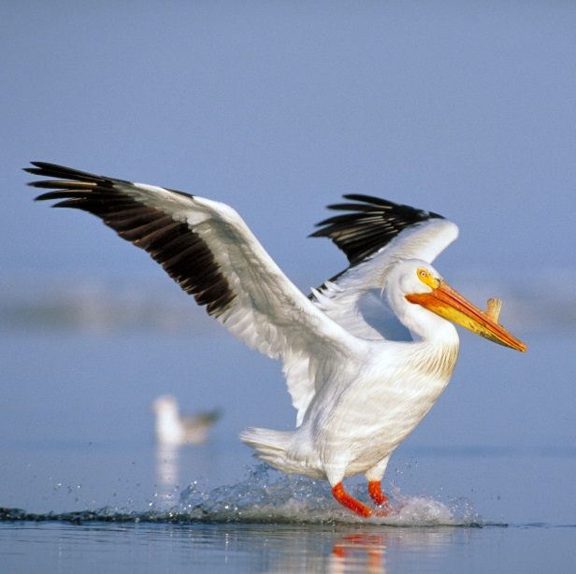
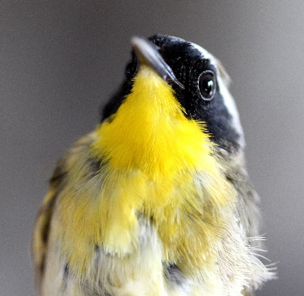
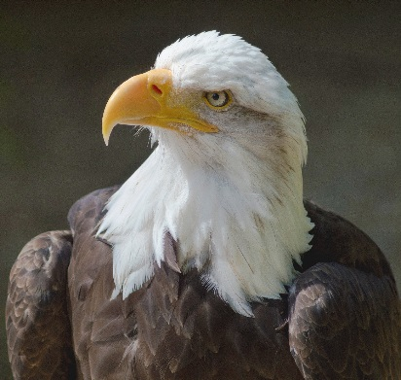
Class Aves - Birds
Key Characteristics:
Hatch from shelled eggs
Endothermic (warm-blooded)
Feathers and wings, but not all can fly
Beaks/bills – no teeth, but can have teeth-like ridges, and will grind or rip apart their food
The most developed eye sight among animals
The most efficient respiratory system among all vertebrates
Bird Examples:
American White Pelican, Common Yellowthroat, Bald Eagle
All photos from Ducks Unlimited Canada.
Notes:
Endothermic – can maintain an internal temperature

Slide 9
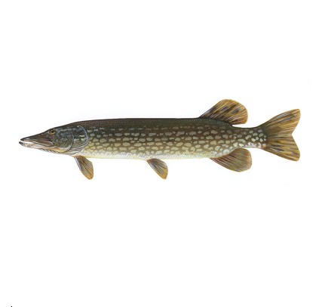
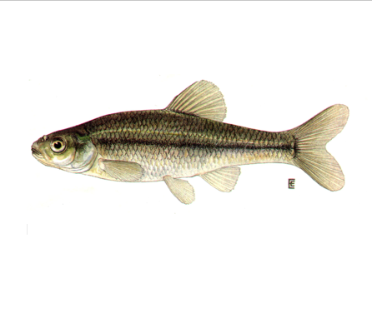
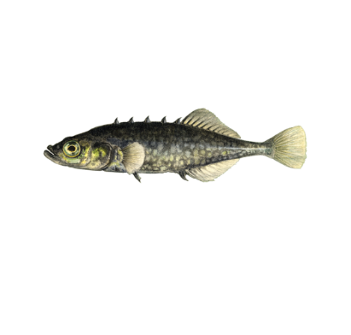
Class Osteichthyes - Bony Fish
Key Characteristics:
Hatch from unshelled (jelly-like) eggs – produce large amount of small eggs
Ectothermic (cold-blooded) with a few exceptions
Skeleton is made up of calcium-based bones
Bilaterally flattened in shape
Swim bladder helps control their buoyancy
Found in both saltwater and freshwater habitats
Bony Fish Examples:
Northern Pike, Fathead Minnow, Brook Stickleback
Northern Pyke image from Wikipedia. Stickleback image from dnr.cornell.edu. Fathead minnow image from earthguide.ucsd.edu/fishes.
Notes:
Fish are more numerous then mammal and bird species combined, so their diversity is vast. Generally, fish are divided into two broad class categories (also known as super classes): a) Osteichthyes (Bony) Fish or b) Cartilaginous Fish (like Sharks, Skates, Rays). These two super classes are further categorized into many sub-classes. In a freshwater wetland habitat, only Bony Fish can be found.
All Bony Fish share the following characteristics:
Produce a large amount of eggs – the majority do not survive (eaten, etc.) only a few will mature into adult fish.
External fertilization where as Cartilaginous Fish fertilize their eggs internally.
Ectothermic – can not maintain an internal temperature; few exceptions (like Bluefin Tuna)
Skeleton of Bony fish are made up of calcium-based bones (like our bones); Cartilaginous Fish skeletons are made of cartilage (like what makes up our noses and ears)
Bilaterally flat as opposed to pancake shape like Cartilaginous Fish (like Sharks)
Only bony fish have swim bladders that help the fish control their buoyancy (to sink or float); Cartilaginous Fish do not have a swim bladder so they depend on lift in order to stay afloat, so if they stop swimming they sink (Bony fish will continue to float if they stop swimming)
Bony fish can be found in freshwater and saltwater environments; on the other hand, all Cartilaginous Fish live only in marine (saltwater) habitats

Slide 10
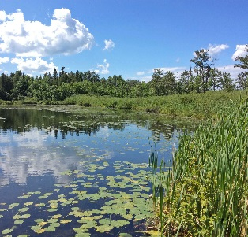
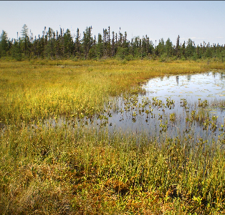
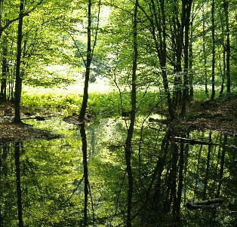
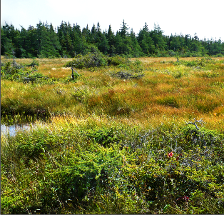
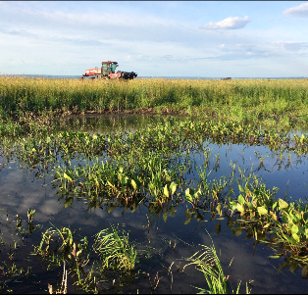
Vertebrates in Wetlands
There are vertebrates from each of these five classes living in wetlands.
Wetlands are shallow bodies of water that promote rich vegetation growth. The type of wetland will also determine what kinds of vertebrates live in these freshwater habitats, for each wetland type provides different kinds of vegetation, nutrients and water levels.
Types of Wetlands:
Freshwater Marsh
Fen
Swamp
Bog
Shallow Open Water

Slide 11
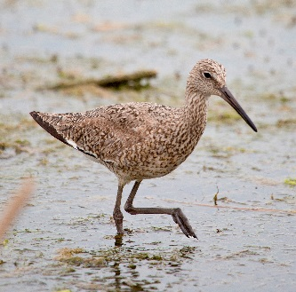

Adaptations
Habitats, like wetlands, are so diverse and constantly changing. These changes can be seasonal (like winter) or unexpected (like habitat loss), so living things must use their adaptations to help them get the food, water, shelter, and space they need in order to survive.
Adaptations are special characteristics that help living things survive. There are two kinds of adaptations: structural and behavioural.
Structural adaptations include the physical features of the living thing.
Behavioural adaptations include how the living thing behaves or acts.
Examples: long legs, wings, sharp teeth, a rabbit’s coat changing colour.
Examples: hibernating, hunting, running away from a predator.
Willet and Painted Turtle image from Ducks Unlimited Canada.

Slide 12
Vertebrate Race
Now its your turn to classify wetland animals into their appropriate class!
Objective: Through a relay race, students will aim to properly classify the animals on the cards
they were given by placing each card into the correct bucket. The team who is the
fastest gets 5 points, then each card who was classified in the correct bucket receives 2
points. The team with the most points wins!
Set Up:
Buckets
Start Line
Students lined up, in their teams, each with a card
How to Play:
1. The class will be divided into two teams, where each student receives one card.

Slide 13
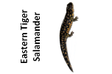

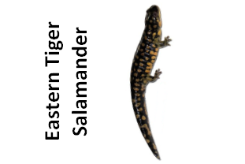
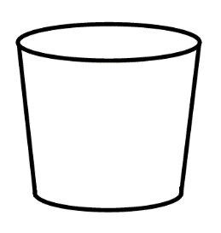
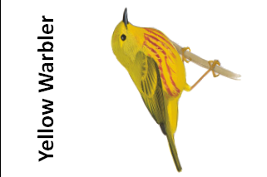
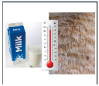
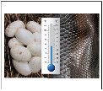
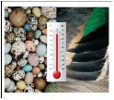
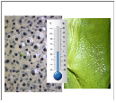
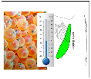
2. The two teams will have a moment to look at their cards and discuss which card belongs
in which bucket. The buckets will be labelled with pictures of specific adaptations
belonging to a specific animal class. Students will have to decide which bucket represents
which animal class.
3. The two teams will line up behind the start line. When the teacher says
‘Go!’ the first student in line from each team will run to the buckets and put their card
into the bucket they think best describes their animal.
4. When the students run back, they tag the next person in line from their team who then
runs to the buckets. Once all students have put their cards in the buckets the game is
finished.

Slide 14
Let’s Play!

Slide 15
Vertebrate Race Discussion
Go through each bucket and make any corrections needed, putting cards in their correct class.
Referencing the cards in each bucket, compare and contrast the adaptations of the animals in each taxonomic class.
1. What are some structural adaptations of animals in each class? Are these adaptations
similar or different compared to other animals in that taxonomic class?
2. What are some behavioural adaptations of animals in each class? Are these
adaptations similar or different compared to other animals in that taxonomic class?
3. How do these adaptations help each animal live in their habitat(s)?

Slide 16
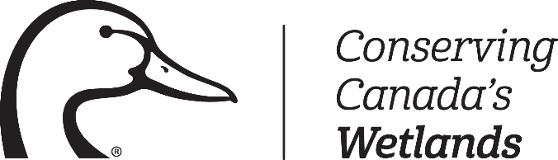

Thank You!

